Slide 1
HEALTH SPENDING IN USA vs OECD COUNTRIES
Why USA Has the Highest National Health Expenditure in the world?
AMANUEL SIDAMO
Data Science Cohort2
NASHVILLE SOFTWARE SCHOOL

Slide 2
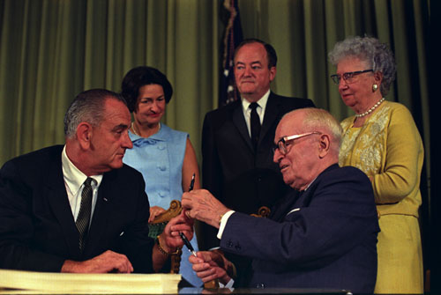
Overview of USA Health Spending
President TRUMAN Proposed a National Health Insurance Plan in 1945, but it was lobbied against by AMA and other groups. That is the diverging point for USA Health Spending from the rest of the world.
20 years later for the first time in 1965 USA passed a bill to establish Medicare and Medicaid. President Truman received the first Medicare Card from the Hand of President Johnson.
USA Spent 17.9% of its GDP in 2017 on Health which is $3.5 trillion .
Highest both in terms of Per Capita Spending
and percentage share of GDP among developed countries.
However, USA health outcomes are not the best among developed countries in measures like :Infant Mortality, Life Expectancy and potential life years lost.

Slide 3
Factors Affecting USA Health Spending
Aging of baby boomers generation
Expansion of Medicare and Medicaid
Increase in Pharmaceutical Prices
For Instance Health care spending increased by more than $900 billion from 1996 to 2013.
More than half of the spending increase was attributed to increased prices for health care services, with lesser contributions from growth and aging of the U.S. population.
Source:(Science Daily November 7,2017 )

Slide 4
OBJECTIVE OF THE PROJECT
Motivation: I Was Curious to Know What Would Explain this Outlying of USA Health Spending Among Developed Countries.
Hypothesis
People are Consuming Healthcare Service Excessively.
USA Healthcare is Technology Intensive
USA Healthcare Has Best Quality
USA Healthcare Providers are Charging High Prices
Now Let’s Move to the App.

Slide 5
Conclusion
Americans are Consuming Relatively Technology Intensive healthcare Services.
USA Healthcare Doesn’t Look Best in Quality, Except in Cancer Treatment.
USA Healthcare Prices are Expensive and Providers are Charging High Markups.
Administration of Healthcare is costing a lot in USA.

